Slide 1
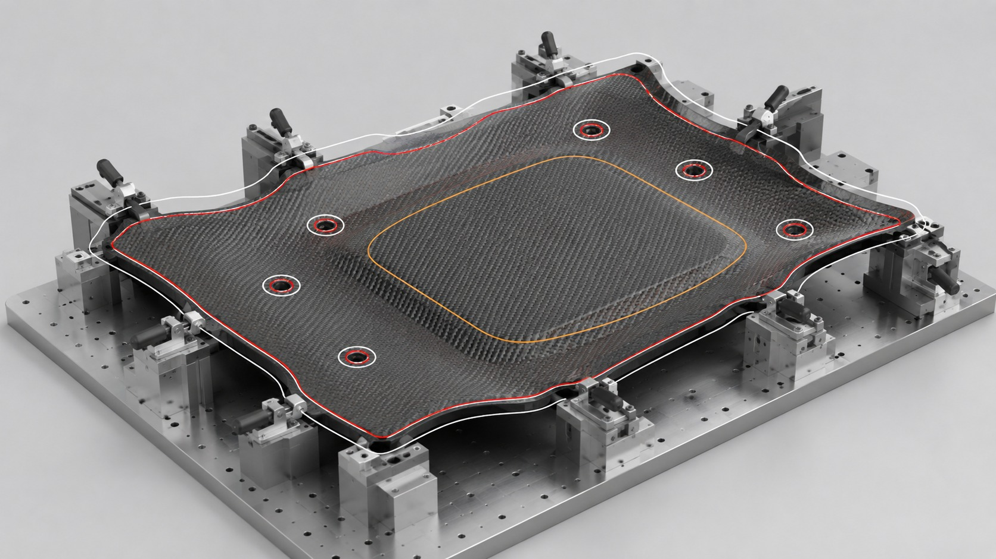

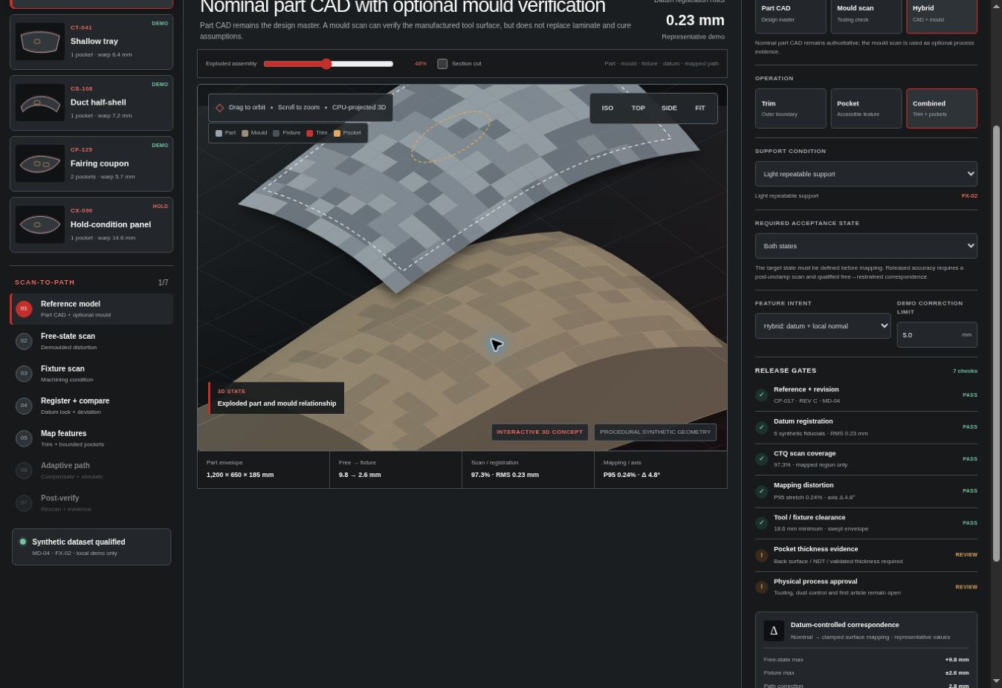
AETEC PRIVATE LIMITED · DSO NATIONAL LABORATORIES
Adaptive
Composite
Processing
R8 technical proposal for scanning, trimming, spraying and sanding
MEASURE • MAP • SIMULATE • VERIFY
2 October 2026 · AETEC in-house proof of concept
Concept demonstrator · Synthetic geometry · Machine-specific qualification required
01
Notes:
AETEC R8 technical proposal. Slides 1–15 retain the adaptive-method explanation from the existing presentation. R8 cell application, separate prices and revised process details follow. Geometry in the retained panel illustrations is conceptual. Customer instruction dated 2 October 2026 governs the pocket through-opening scope.

Slide 2
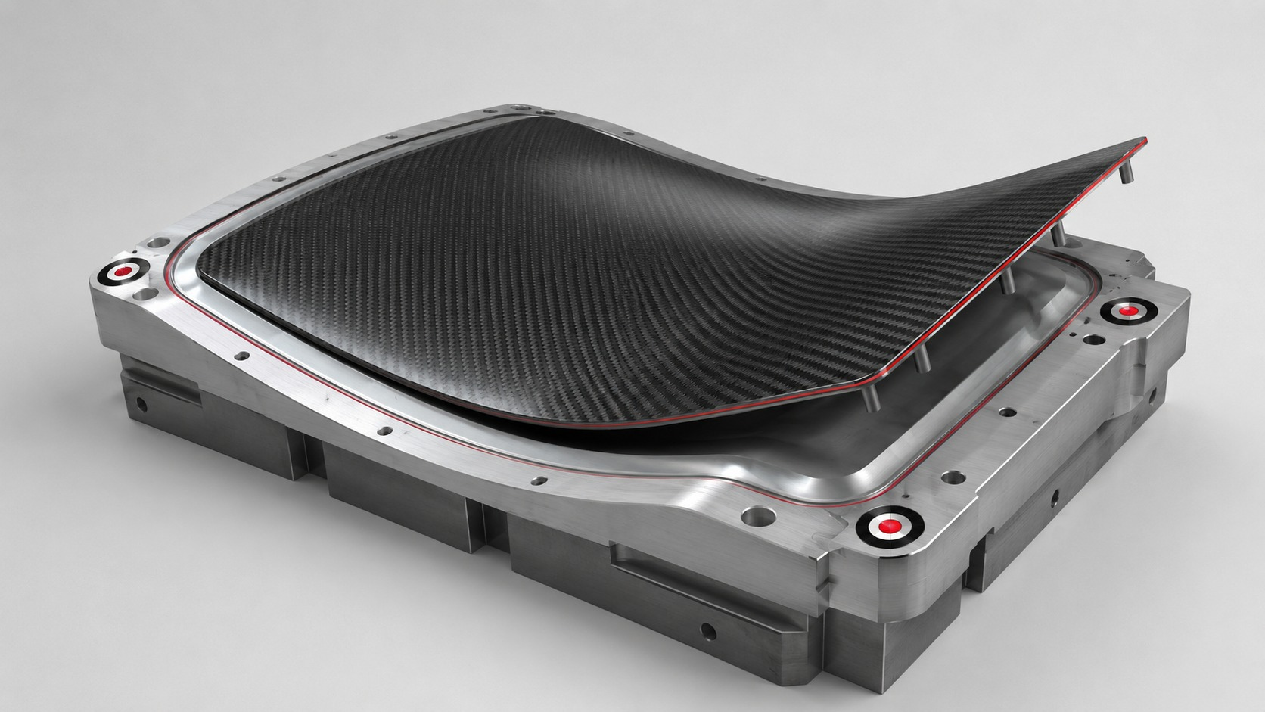
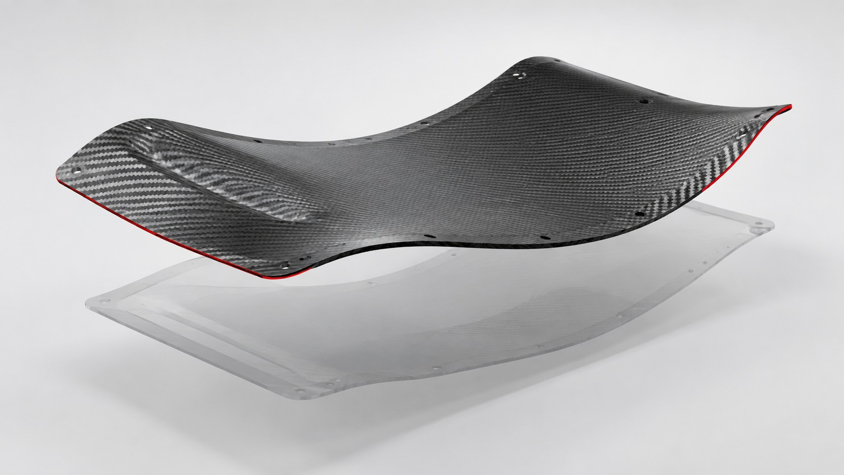
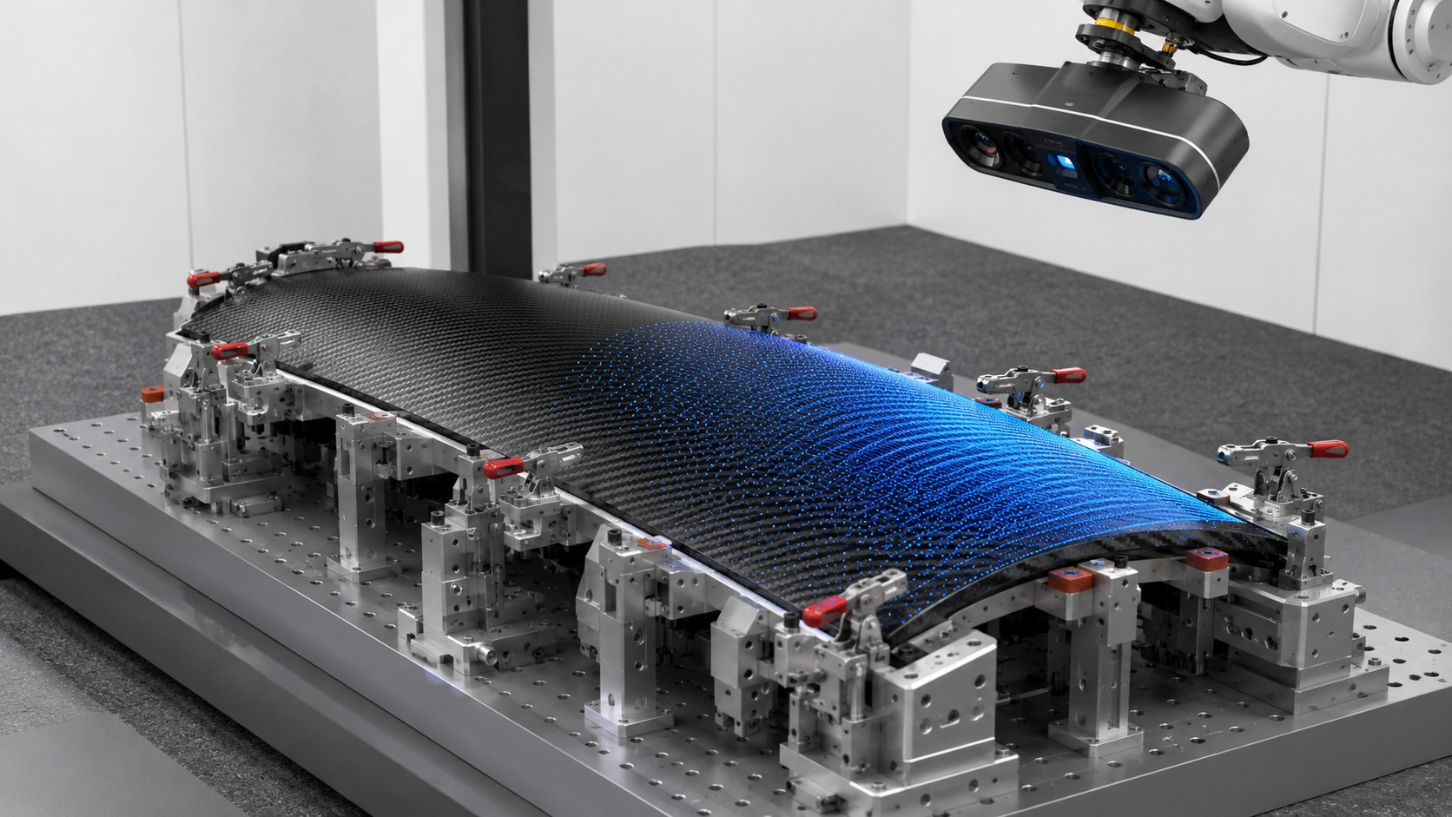
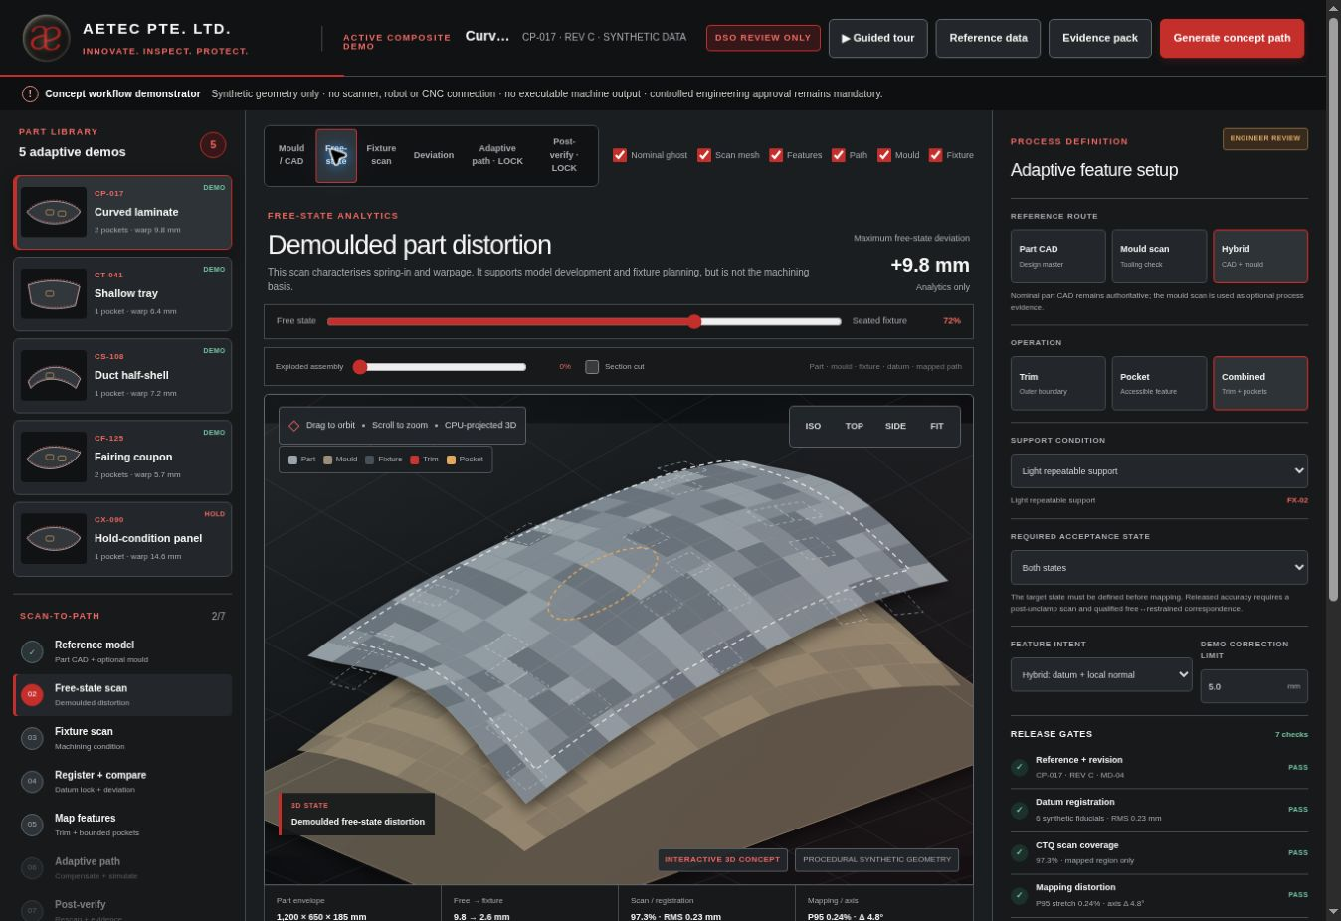
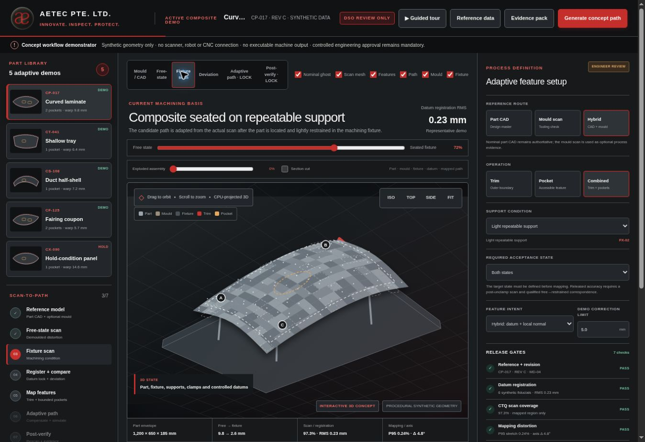
THE ENGINEERING PROBLEM
The panel changes shape after leaving the mould
The same flexible panel can present three different surfaces during production.
→
→
01
On the mould
02
After removal
03
Mounted for machining
Forming surface and cure history
Inward distortion, twist and edge curl
Controlled location, restraint and support
The approved design defines the feature. The mounted measurement shows the actual surface available for evaluation.
Concept demonstrator · Synthetic geometry · Machine-specific qualification required
02
Notes:
AETEC R8 technical proposal. Slides 1–15 retain the adaptive-method explanation from the existing presentation. R8 cell application, separate prices and revised process details follow. Geometry in the retained panel illustrations is conceptual. Customer instruction dated 2 October 2026 governs the pocket through-opening scope.

Slide 3
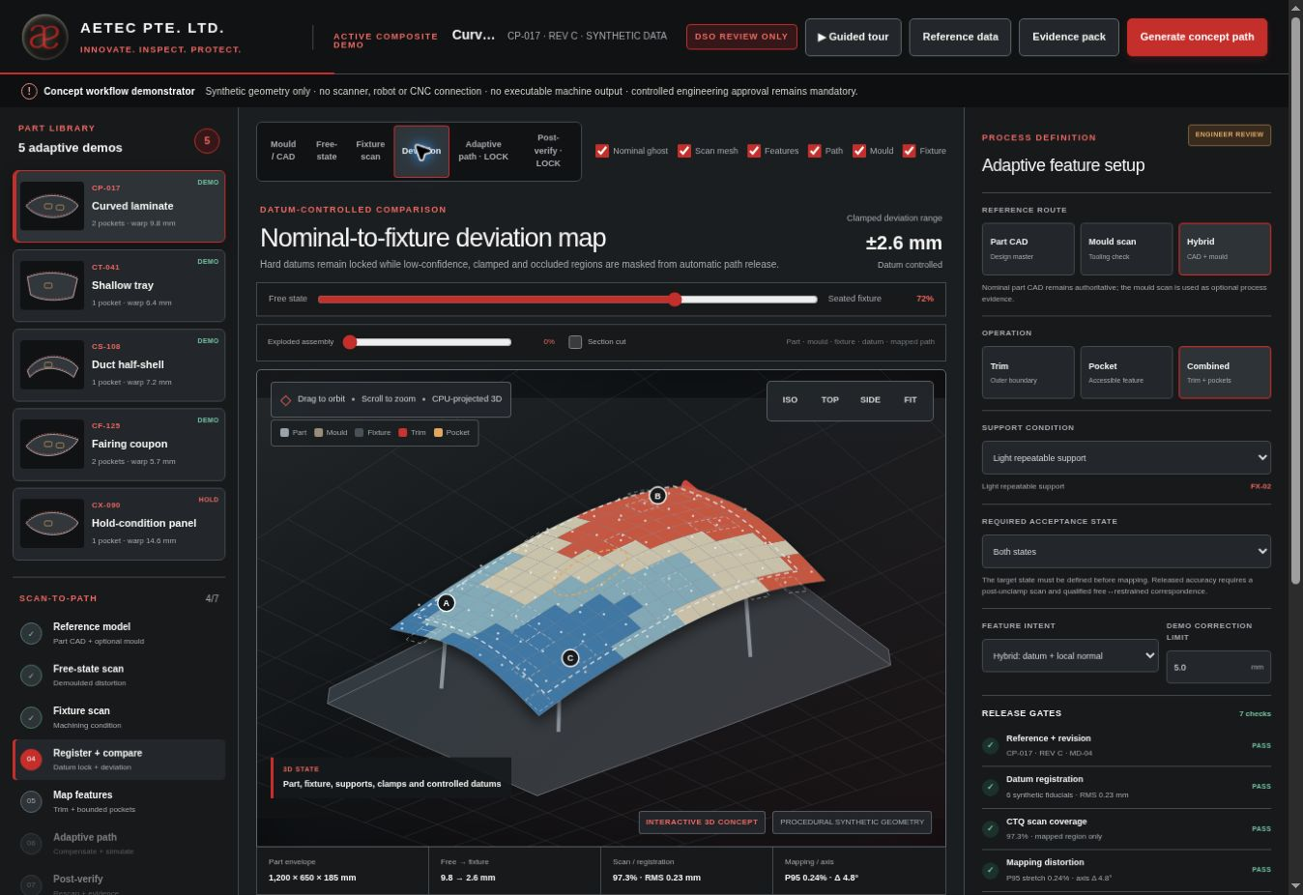
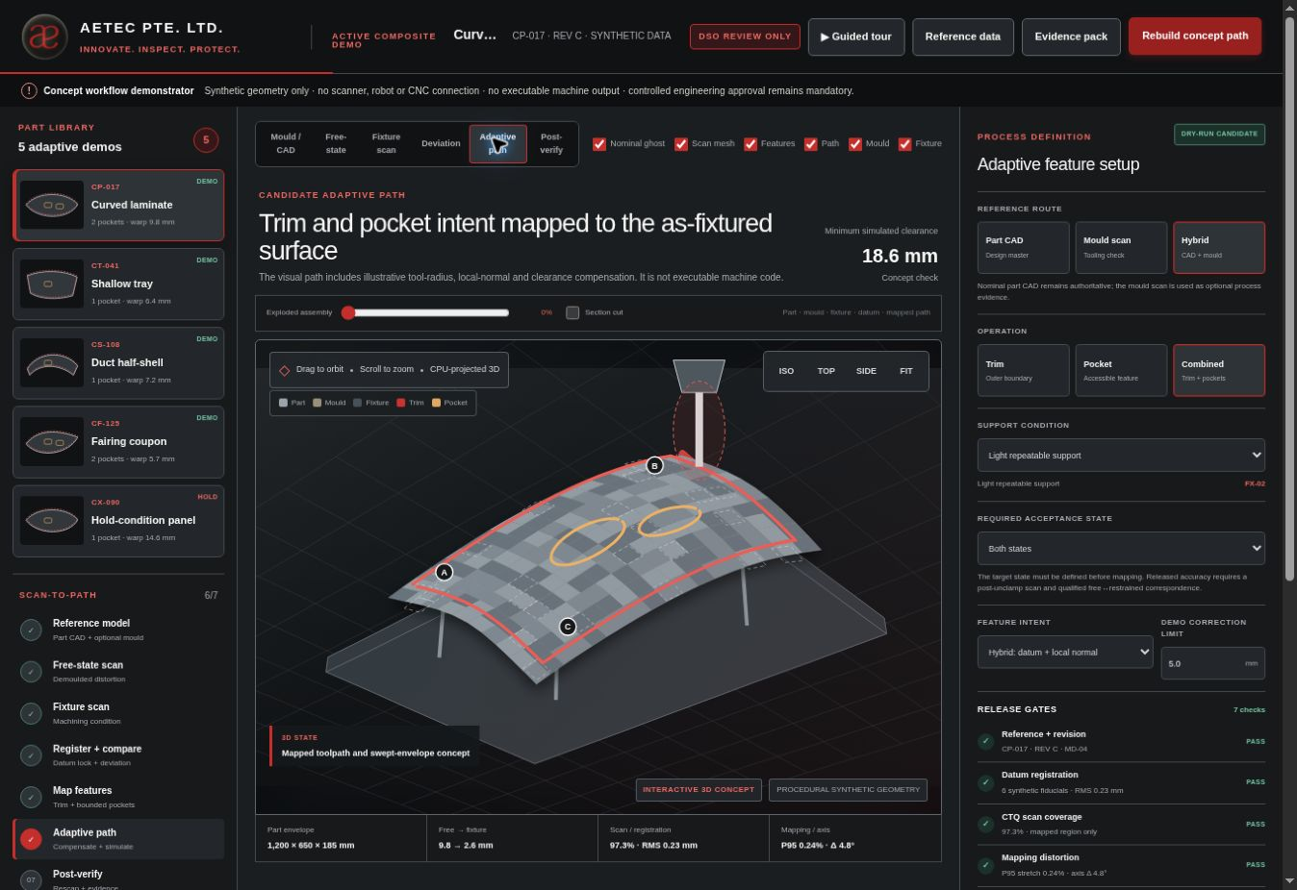
FOUR GEOMETRY STATES
Each state answers a different engineering question
→
→
→
1
Approved design
2
Manufacturing mould
3
Unrestrained part
4
Mounted part
Feature requirements and controlled references
Forming evidence and optional process verification
Distortion analysis and fixture strategy
Measured surface used for a proposed path
The mounted measurement supplies geometric input; calibration, design requirements, process limits and engineering approval remain mandatory.
Concept demonstrator · Synthetic geometry · Machine-specific qualification required
03
01
Approved design
02
Manufacturing mould
03
Unrestrained part
04
Mounted part
Notes:
AETEC R8 technical proposal. Slides 1–15 retain the adaptive-method explanation from the existing presentation. R8 cell application, separate prices and revised process details follow. Geometry in the retained panel illustrations is conceptual. Customer instruction dated 2 October 2026 governs the pocket through-opening scope.

Slide 4
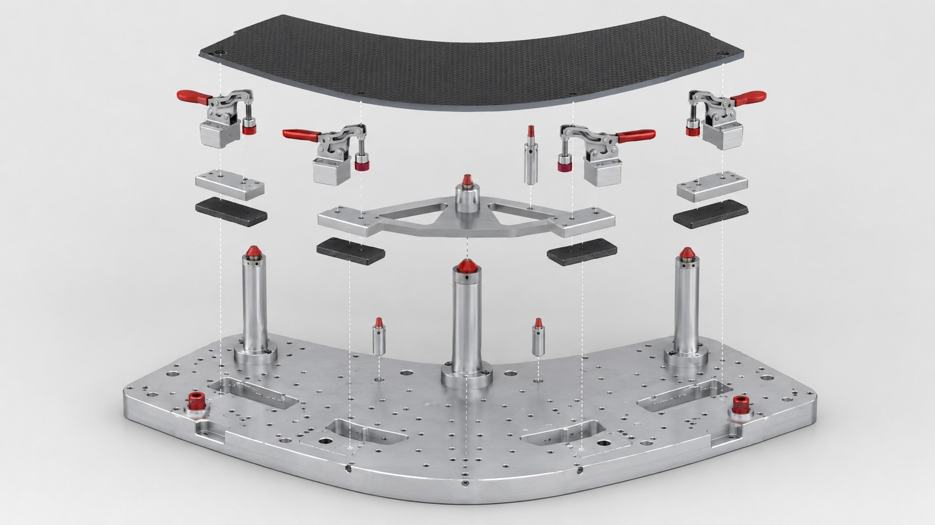
FIXTURE CONCEPT
The fixture creates a repeatable machining condition
1
Locate from physical references
Primary support, secondary locator and tertiary stop establish the coordinate system.
2
Support the cutting zone
Adjustable pads and backing resist movement without forcing the panel into an artificial shape.
3
Clamp with a controlled sequence
The same clamp order and restraint must be used for measurement and machining.
Concept demonstrator · Synthetic geometry · Machine-specific qualification required
04
Notes:
AETEC R8 technical proposal. Slides 1–15 retain the adaptive-method explanation from the existing presentation. R8 cell application, separate prices and revised process details follow. Geometry in the retained panel illustrations is conceptual. Customer instruction dated 2 October 2026 governs the pocket through-opening scope.

Slide 5
MOUNTED-PART MEASUREMENT
Measure the part in the same condition used for cutting
1
Complete the clamp sequence
Verify that location, support and restraint match the approved setup.
2
Measure the actual surface
Capture the feature areas, reference hardware and areas close to clamps.
3
Record coverage and confidence
Unmeasured or shadowed regions cannot be used for adaptive mapping.
Concept demonstrator · Synthetic geometry · Machine-specific qualification required
05
Notes:
AETEC R8 technical proposal. Slides 1–15 retain the adaptive-method explanation from the existing presentation. R8 cell application, separate prices and revised process details follow. Geometry in the retained panel illustrations is conceptual. Customer instruction dated 2 October 2026 governs the pocket through-opening scope.

Slide 6
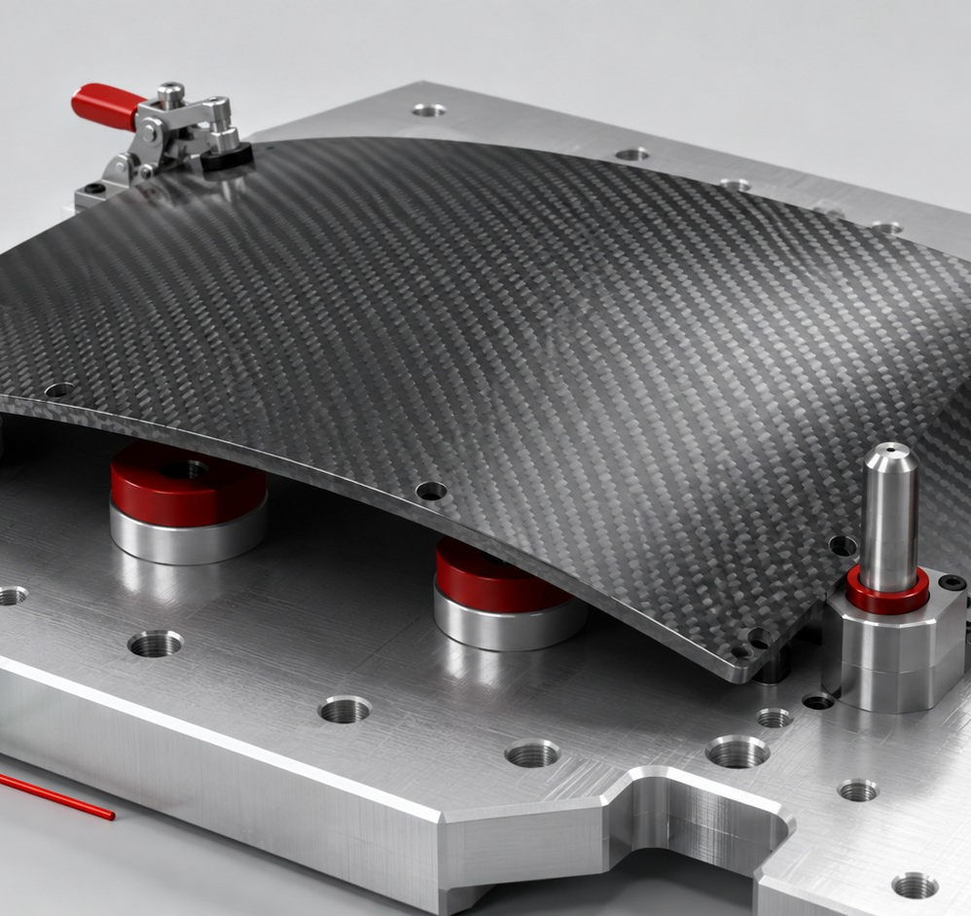
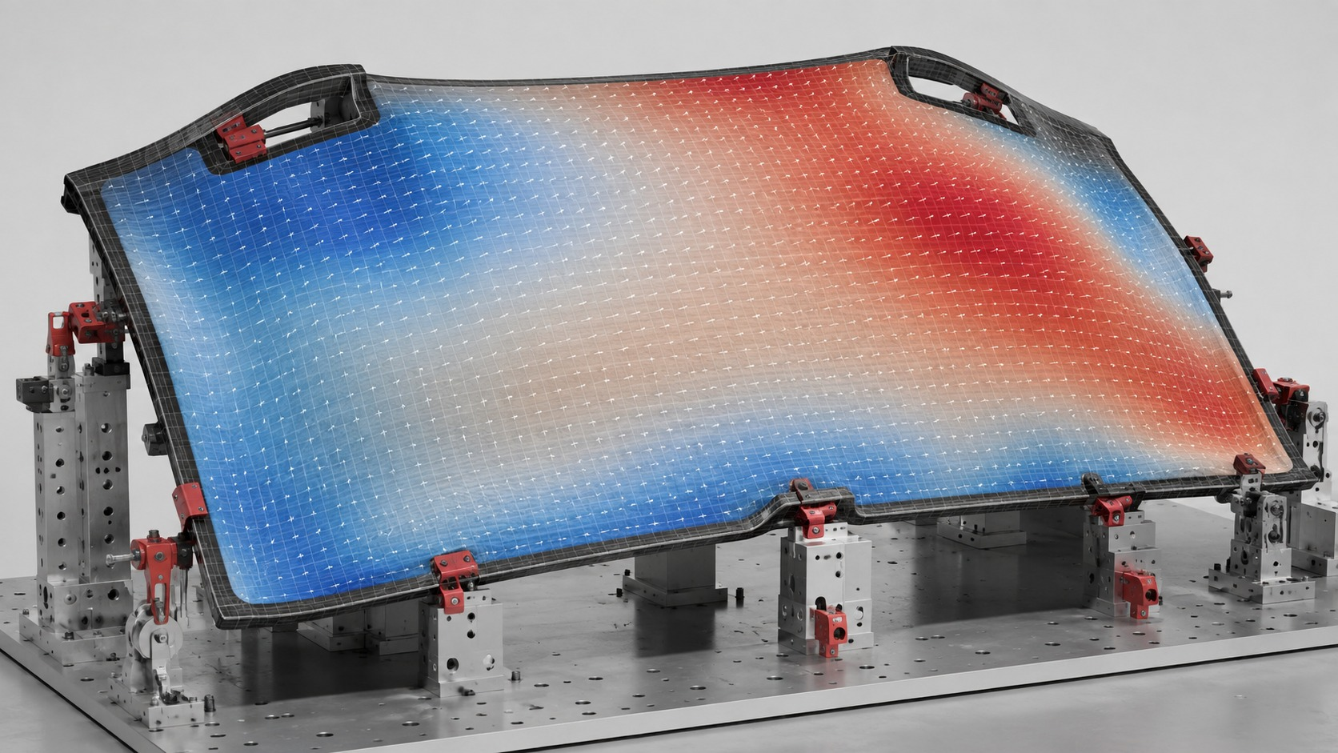
REGISTRATION AND COMPARISON
Physical references connect measurement to design intent
→
→
→
01
Locate
02
Measure
03
Register
04
Assess
Seat the panel on the controlled references
Capture the final mounted surface
Align the measured data to the reference system
Review deviation and measurement confidence
Rigid reference alignment comes first. Local deformation mapping is evaluated only after the controlled coordinate system is established.
Concept demonstrator · Synthetic geometry · Machine-specific qualification required
06
Notes:
AETEC R8 technical proposal. Slides 1–15 retain the adaptive-method explanation from the existing presentation. R8 cell application, separate prices and revised process details follow. Geometry in the retained panel illustrations is conceptual. Customer instruction dated 2 October 2026 governs the pocket through-opening scope.

Slide 7
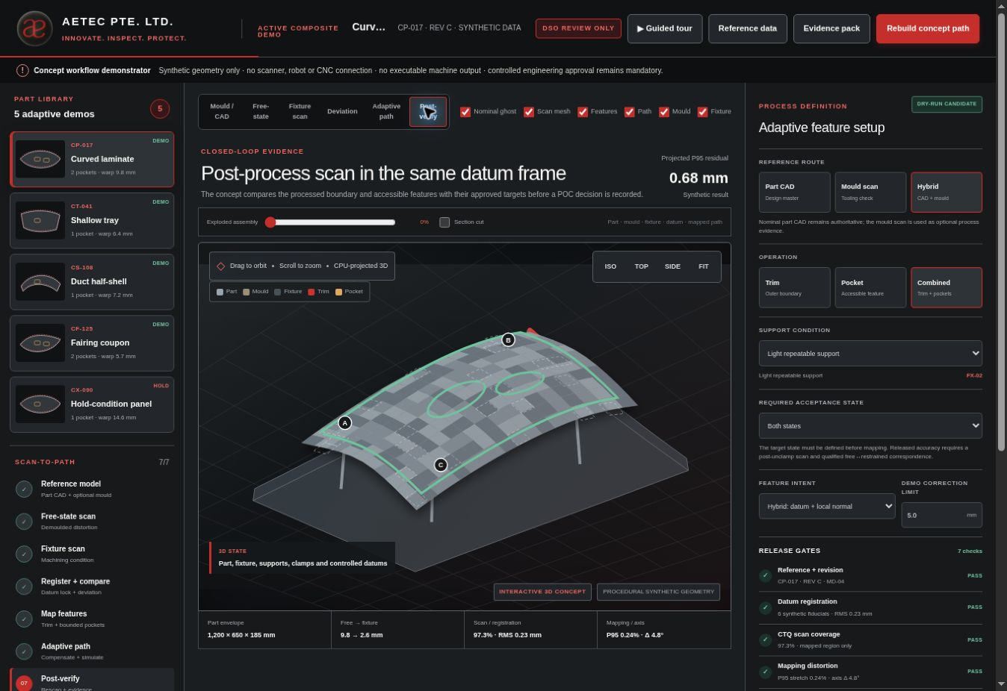
DEVIATION AND CONFIDENCE
Deviation shows what changed; confidence decides whether it may be used
MEASURED MOUNTED SURFACE
Deviation from the approved design
Measurement confidence
Required evidence
✓
Input revisions and measurement settings
✓
Reference alignment and coverage record
✓
Surface correspondence for each feature
✓
Recorded engineering checkpoint results
✓
Decision: proceed, revise or stop
Illustrative data only — no qualified capability is claimed
Concept demonstrator · Synthetic geometry · Machine-specific qualification required
07
Deviation map
Change from the approved design
Confidence
Coverage, alignment and calibration
Notes:
AETEC R8 technical proposal. Slides 1–15 retain the adaptive-method explanation from the existing presentation. R8 cell application, separate prices and revised process details follow. Geometry in the retained panel illustrations is conceptual. Customer instruction dated 2 October 2026 governs the pocket through-opening scope.

Slide 8
FEATURE-SPECIFIC MAPPING
Edge trimming, holes and pockets need different rules
1
Edge trimming
Transfer the boundary along reliable surface correspondence while preserving the defined references.
2
Hole position and direction
Maintain the design-plane location and required axis relative to controlled references.
3
Pocket through-opening
Cut the black pocket boundary into an opening. Qualify backing, cut-out retention and edge quality.
Concept demonstrator · Synthetic geometry · Machine-specific qualification required
08
Notes:
AETEC R8 technical proposal. Slides 1–15 retain the adaptive-method explanation from the existing presentation. R8 cell application, separate prices and revised process details follow. Geometry in the retained panel illustrations is conceptual. Customer instruction dated 2 October 2026 governs the pocket through-opening scope.

Slide 9
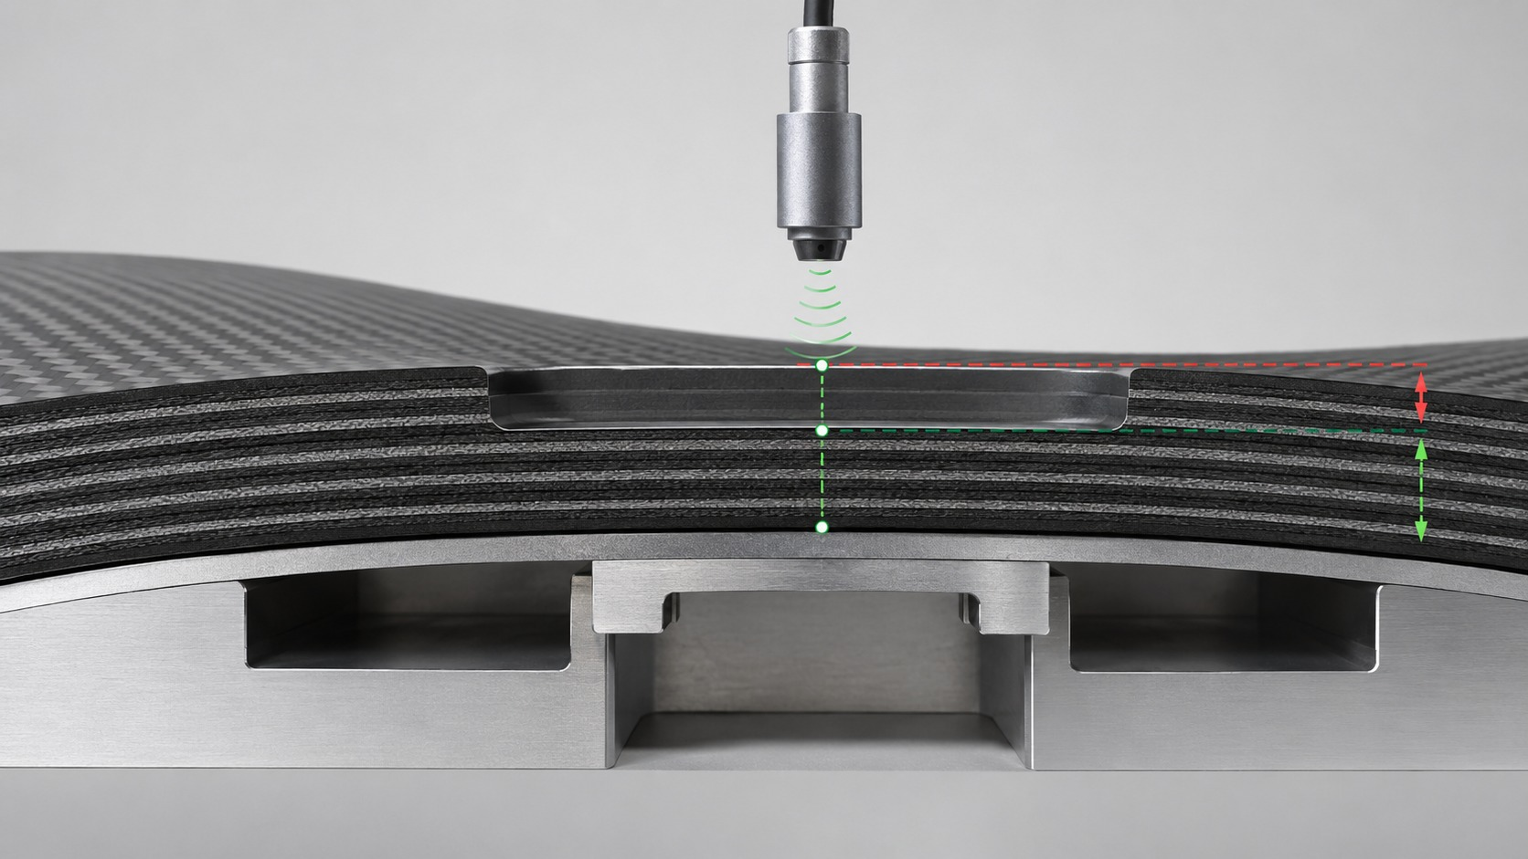
THICKNESS EVIDENCE
Coating decisions need qualified thickness evidence
1
Qualify the comparison method
Compare pre-coat and post-coat scans in the same fixture frame, with direct reference checks.
2
Separate coating from deformation
Control registration, temperature, fixture movement and uncertainty before correcting coating.
3
Inhibit uncertain corrections
Leave unmeasured regions and the pocket opening outside automatic sanding and re-spray paths.
Concept demonstrator · Synthetic geometry · Machine-specific qualification required
09
Notes:
AETEC R8 technical proposal. Slides 1–15 retain the adaptive-method explanation from the existing presentation. R8 cell application, separate prices and revised process details follow. Geometry in the retained panel illustrations is conceptual. Customer instruction dated 2 October 2026 governs the pocket through-opening scope.

Slide 10
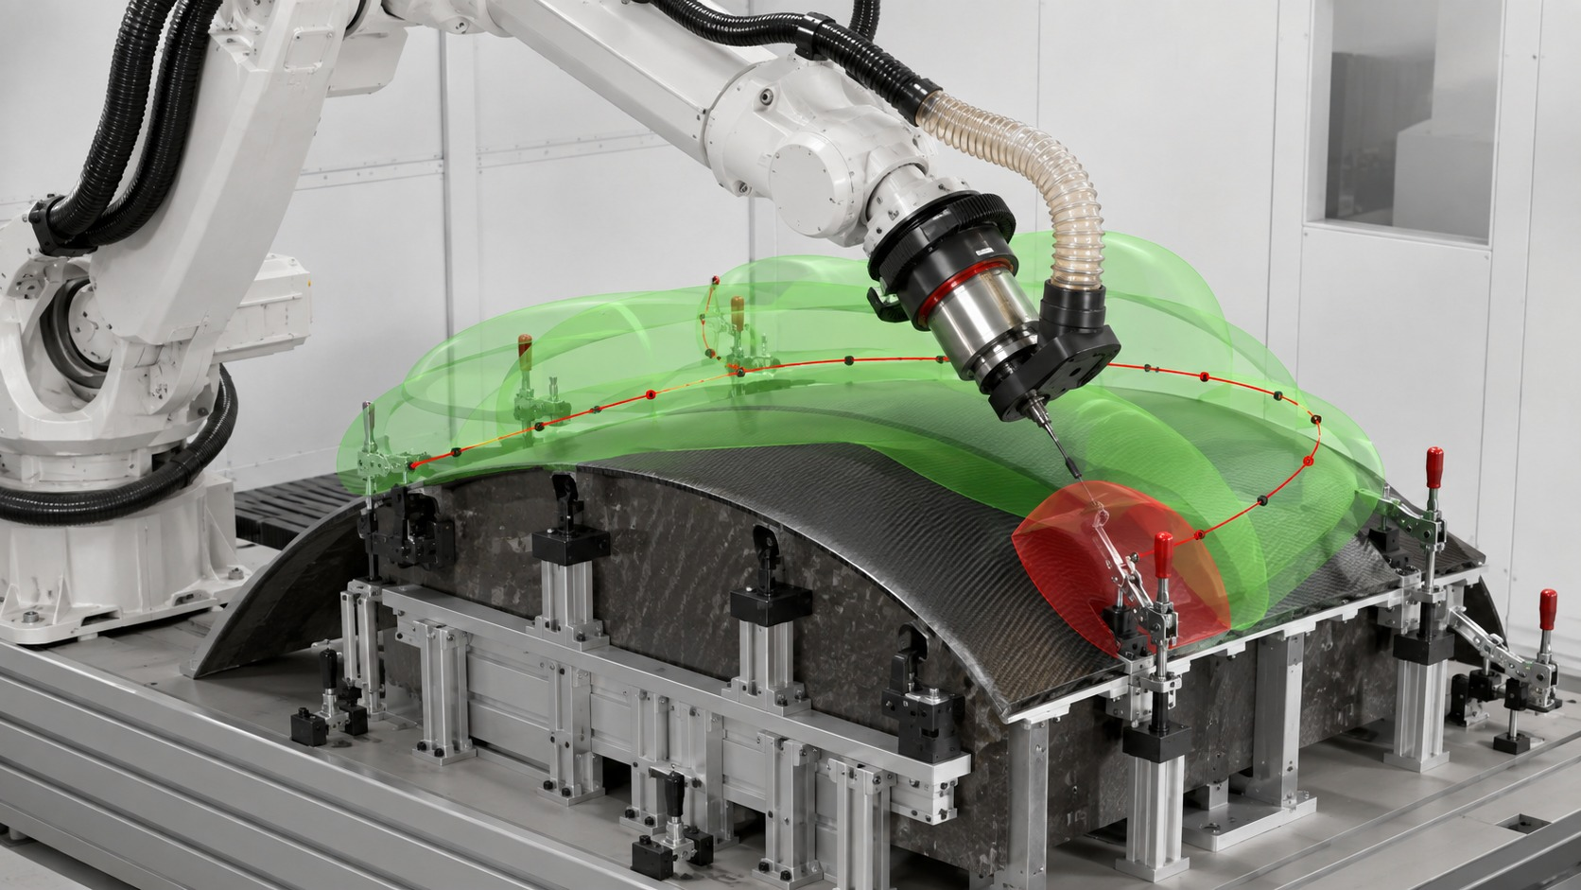
REACH AND COLLISION
Check the complete tool system before any machine movement
1
Simulate the full assembly
Include cutter, holder, spindle, dust hood, extraction hose and every fixture component.
2
Check reach and orientation
Confirm machine travel, joint limits, stiffness and tool direction along the whole path.
3
Reject blocked regions
A clear cutter tip is insufficient when the holder or attachments can strike a clamp.
Concept demonstrator · Synthetic geometry · Machine-specific qualification required
10
Notes:
AETEC R8 technical proposal. Slides 1–15 retain the adaptive-method explanation from the existing presentation. R8 cell application, separate prices and revised process details follow. Geometry in the retained panel illustrations is conceptual. Customer instruction dated 2 October 2026 governs the pocket through-opening scope.

Slide 11
ENGINEERING ASSESSMENT
Adaptive edge and pocket-opening trials
The concept is suitable for controlled evaluation, with scope increasing only as evidence improves.
→
→
01
Accessible edge trimming
02
Pocket through-opening
03
Production contours and tolerances
Strong first proof-of-concept case
Backing, retention and edge-quality trials
Release against approved customer CAD
R8 trimming includes the approved edge and black pocket opening as a separate S$150,000 POC package.
Concept demonstrator · Synthetic geometry · Machine-specific qualification required
11
Notes:
AETEC R8 technical proposal. Slides 1–15 retain the adaptive-method explanation from the existing presentation. R8 cell application, separate prices and revised process details follow. Geometry in the retained panel illustrations is conceptual. Customer instruction dated 2 October 2026 governs the pocket through-opening scope.

Slide 12
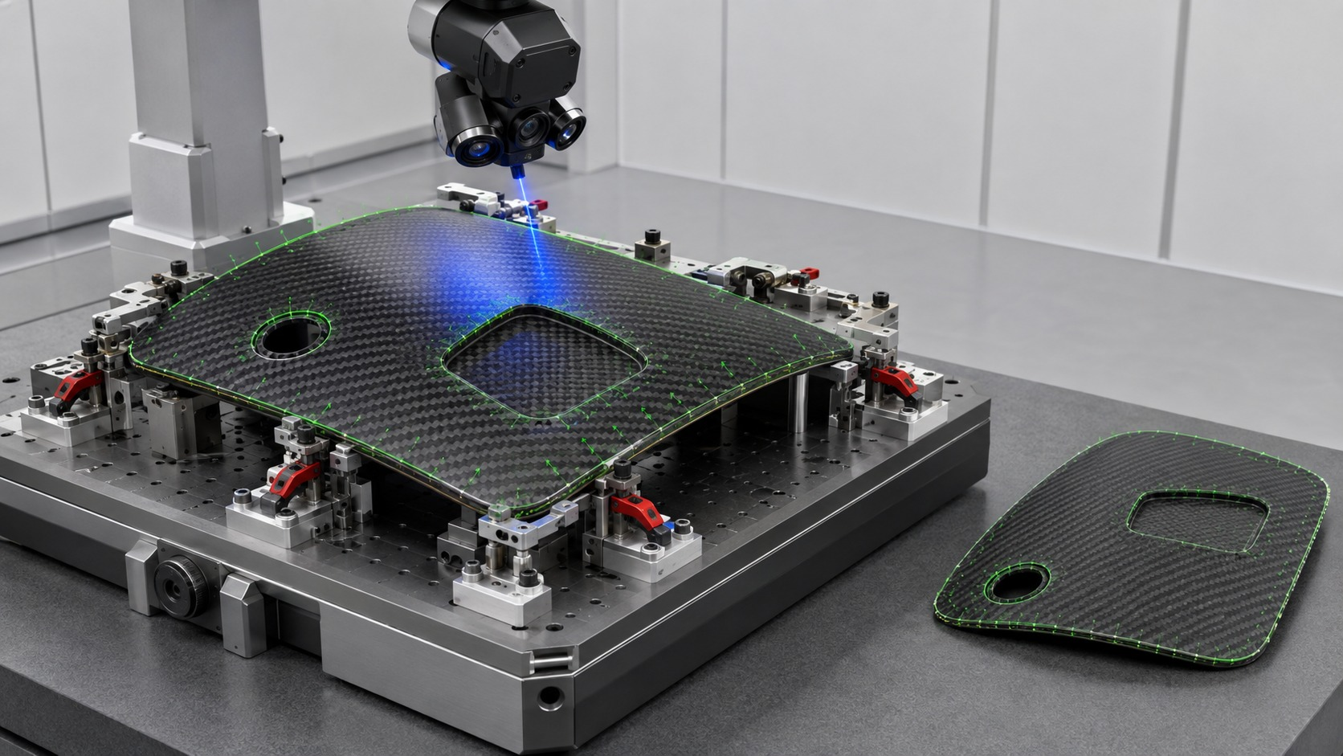
POST-PROCESS VERIFICATION
Acceptance must be measured in the condition agreed with the customer
MEASURE AGAINST THE SAME REFERENCES
Measure while mounted
Measure after fixture release
Verification record
✓
Input revisions and approved requirements
✓
Reference alignment and coverage record
✓
Feature deviations and measurement uncertainty
✓
Mounted and released acceptance conditions
✓
Engineer records accept, corrective work or stop
Use actual released-state measurement unless the deformation model is validated
Concept demonstrator · Synthetic geometry · Machine-specific qualification required
12
While mounted
Check the machined result before changing restraint
After fixture release
Measure the unrestrained part when required
Notes:
AETEC R8 technical proposal. Slides 1–15 retain the adaptive-method explanation from the existing presentation. R8 cell application, separate prices and revised process details follow. Geometry in the retained panel illustrations is conceptual. Customer instruction dated 2 October 2026 governs the pocket through-opening scope.

Slide 13
APPLICATION GUIDE
Use the application in six governed actions
1
Choose a representative part
3
Begin with a sample that matches the intended feature type.
2
Review the geometry stages
1
4
Inspect the approved design, mould, free condition and mounted condition.
3
Inspect the three-dimensional scene
Rotate, zoom, explode the fixture and open a section view.
2
5
4
Define the process
Select the reference, operation, support and acceptance condition.
5
Generate a proposed path
Display the candidate only after the concept checks are complete.
6
6
Review the evidence record
Confirm assumptions, unresolved risks and the recorded outcome.
Concept demonstrator · Synthetic geometry · Machine-specific qualification required
13
Notes:
AETEC R8 technical proposal. Slides 1–15 retain the adaptive-method explanation from the existing presentation. R8 cell application, separate prices and revised process details follow. Geometry in the retained panel illustrations is conceptual. Customer instruction dated 2 October 2026 governs the pocket through-opening scope.

Slide 14
IMPLEMENTATION STAGES
Increase scope only after each stage proves repeatability and safety
Start with one representative part and measurable acceptance criteria.
QUALIFICATION
4
DEPLOYMENT
2
PILOT
3
1
PROOF OF CONCEPT
Measurement-system study, capability and safety
Controlled revisions, training and traceability
One panel and one accessible boundary
Representative part family
Qualified machine instructions and controls
Post-process evidence and change control
Measurement, simulation and verification
Operator flow, repeatability and cutting stability
ENGINEERING CHECKPOINT
ENGINEERING CHECKPOINT
ENGINEERING CHECKPOINT
CUSTOMER-APPROVED RELEASE
SELECT THE STARTING PART
Agree references, tolerance, acceptance condition, feature scope and stop rules
Concept demonstrator · Synthetic geometry · Machine-specific qualification required
14
Notes:
AETEC R8 technical proposal. Slides 1–15 retain the adaptive-method explanation from the existing presentation. R8 cell application, separate prices and revised process details follow. Geometry in the retained panel illustrations is conceptual. Customer instruction dated 2 October 2026 governs the pocket through-opening scope.

Slide 15
R8 TECHNICAL PROPOSAL
R8 cell
design and
POC scope
The following design applies the adaptive method to the DSO component
DEFINE • MEASURE • SIMULATE • VERIFY
Separate scanning, spraying, adaptive trimming and adaptive sanding packages
Concept demonstrator · Synthetic geometry · Machine-specific qualification required
15
Notes:
AETEC R8 technical proposal. Slides 1–15 retain the adaptive-method explanation from the existing presentation. R8 cell application, separate prices and revised process details follow. Geometry in the retained panel illustrations is conceptual. Customer instruction dated 2 October 2026 governs the pocket through-opening scope.

Slide 16

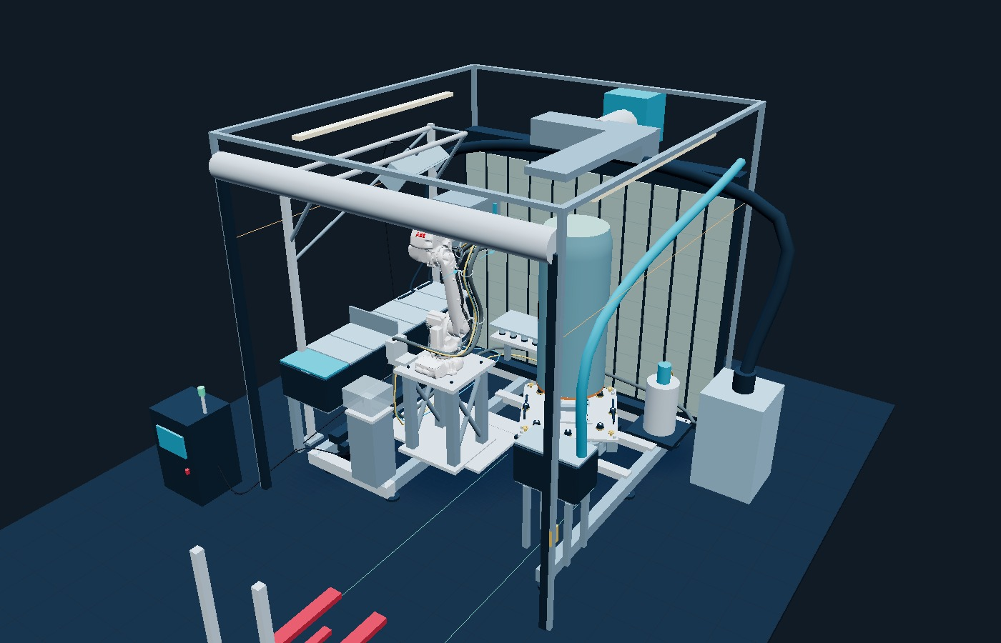
R8 CELL DESIGN
POC and final-cell layout
Proposed envelope
4,200 × 4,600 × 4,500 mm. Full-width roller shutter with 4,000 mm clear opening.
POC and final study
1.4 m POC sample. 2.1 m final part study. One vertical-axis turntable and one fixture.
Robot platform
ABB IRB 4600-40/2.55 on a fixed 1,500 mm pedestal. Keep the 1,300 mm loading lane clear.
AETEC · DSO · 2 October 2026 · Concept for engineering review
16
Notes:
Source: current R8 simulation design.json. Proposed dimensions require site and engineering release. OEM ABB STEP geometry retained from the R7 application.

Slide 17
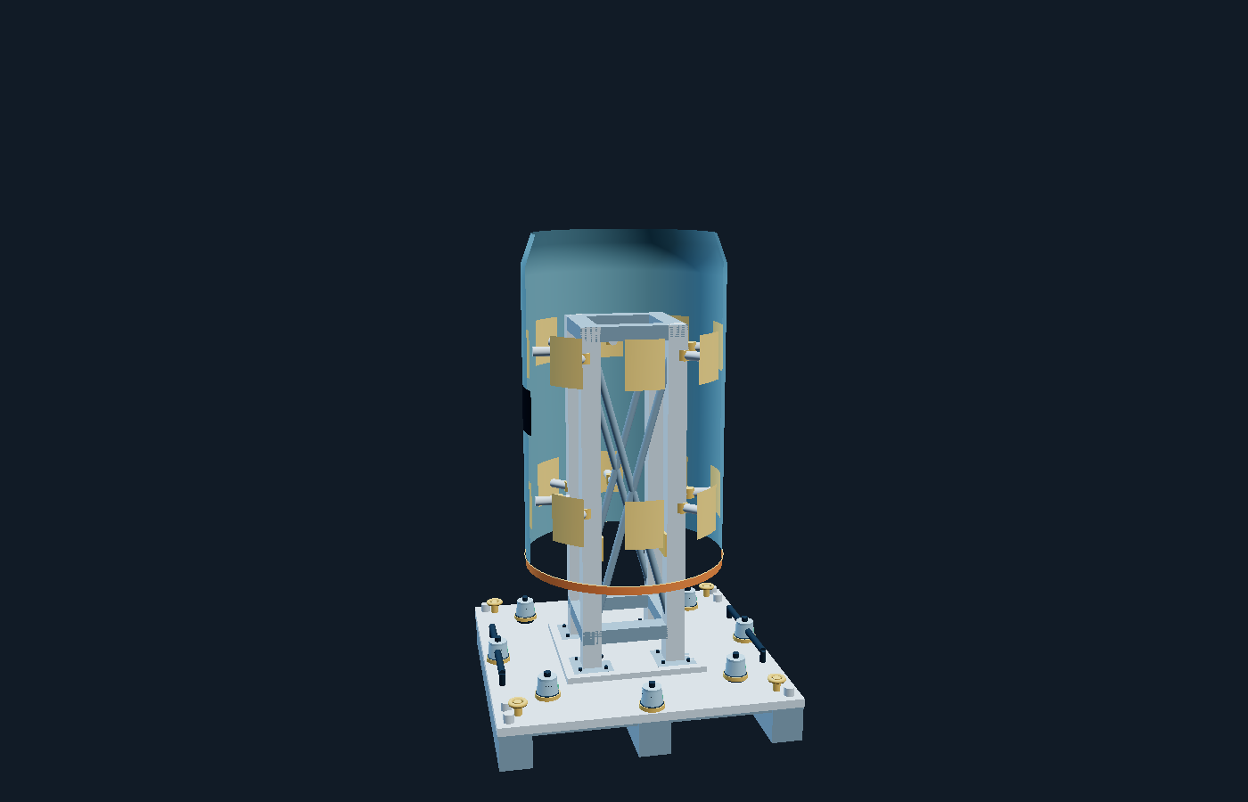
R8 CELL DESIGN
Raised fixture and retained references
Rigid support
Four closed box columns, braces and broad internal expansion shoes. Positive screw retention.
Clear cutting zones
Raise the edge above protected base targets. Qualify pocket backing and cut-out retention.
Handling and datum
1,240 mm square aluminium pallet, fork pockets, grips and lifting eyes. Permanent targets stay fixed.
AETEC · DSO · 2 October 2026 · Concept for engineering review
17
Notes:
Source: user fixture instructions and R8 design. Load capacity, laminate contact pressure, clamp forces and transport stability require validation.

Slide 18
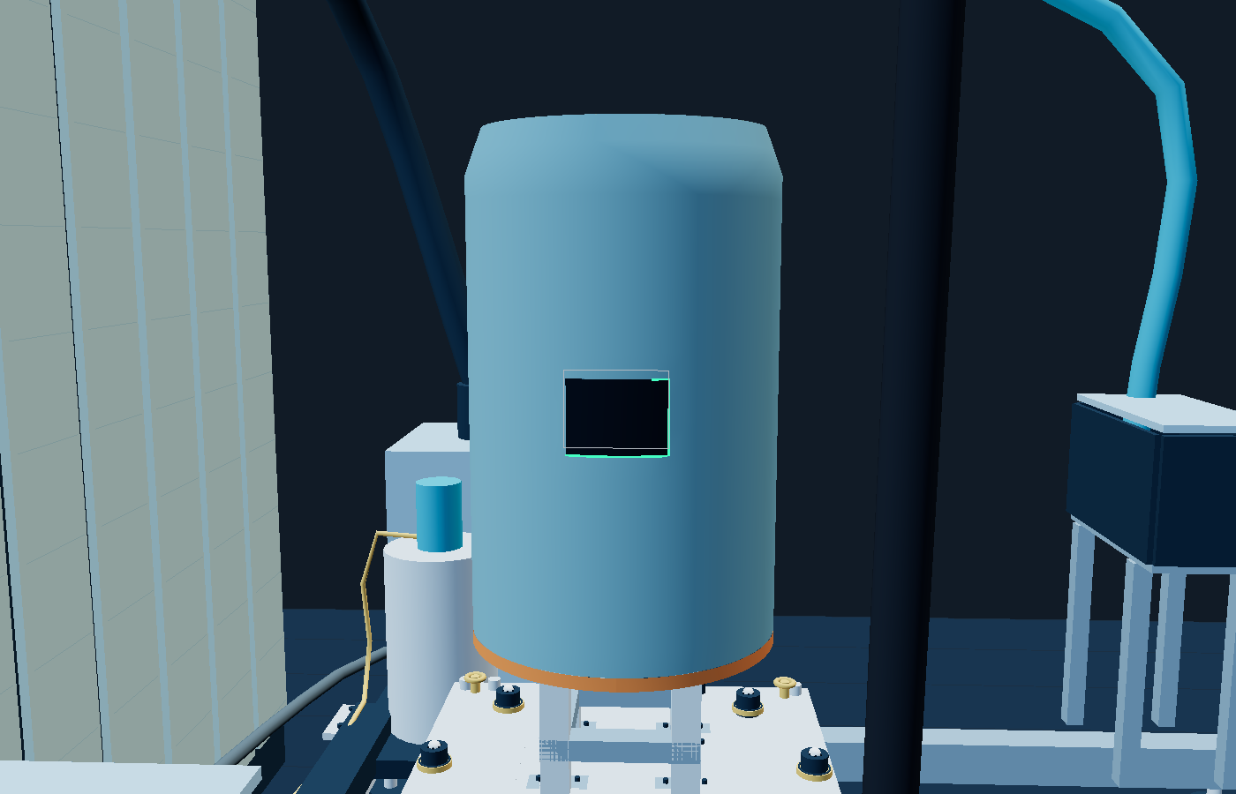
R8 CELL DESIGN
Adaptive pocket-opening trimming
Scan after clamping
Resolve rigid displacement first. Evaluate local distortion and optical confidence in the mounted state.
Generate the contour
Grey shows nominal geometry. Green shows the adjusted path. Preserve the approved feature references.
Cut the opening
Trim the edge and black pocket through-opening. Capture dust and retain the cut-out. Verify the result.
AETEC · DSO · 2 October 2026 · Concept for engineering review
18
Notes:
Source: customer Hole Cutout Parasolid filename and instruction 2 October 2026. The animated opening and exaggerated nominal offset are parameterised demonstrations, not translated native customer CAD. Exact geometry and cutting release remain required.

Slide 19
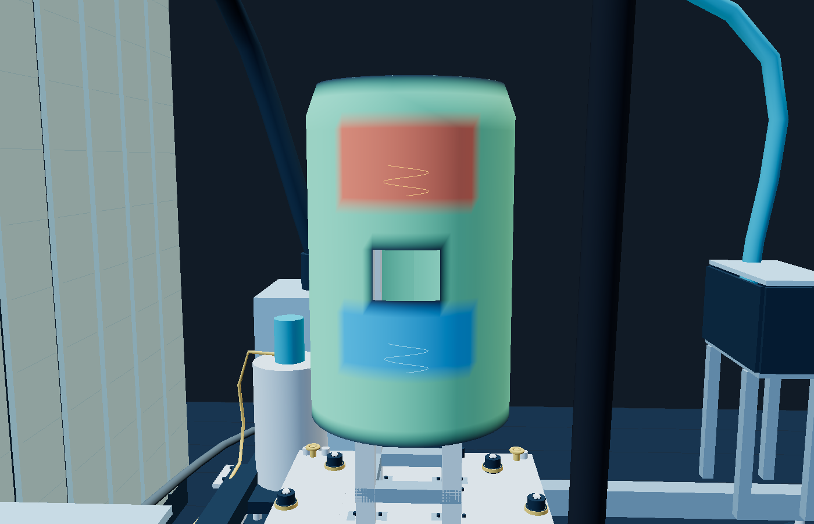
R8 CELL DESIGN
Selective coating correction
Thick regions
Generate bounded sanding paths over verified excess coating. Use compliant force and local extraction.
Thin regions
Generate local re-spray paths. Cover targets and optics, apply paint, then condition and clear the atmosphere.
Verify again
Clean and rescan in the unchanged fixture frame. Limit iterations and record unresolved areas.
AETEC · DSO · 2 October 2026 · Concept for engineering review
19
Notes:
Synthetic coating map and path demonstration. Qualify surface-difference inference against direct references. No measured performance is claimed.

Slide 20
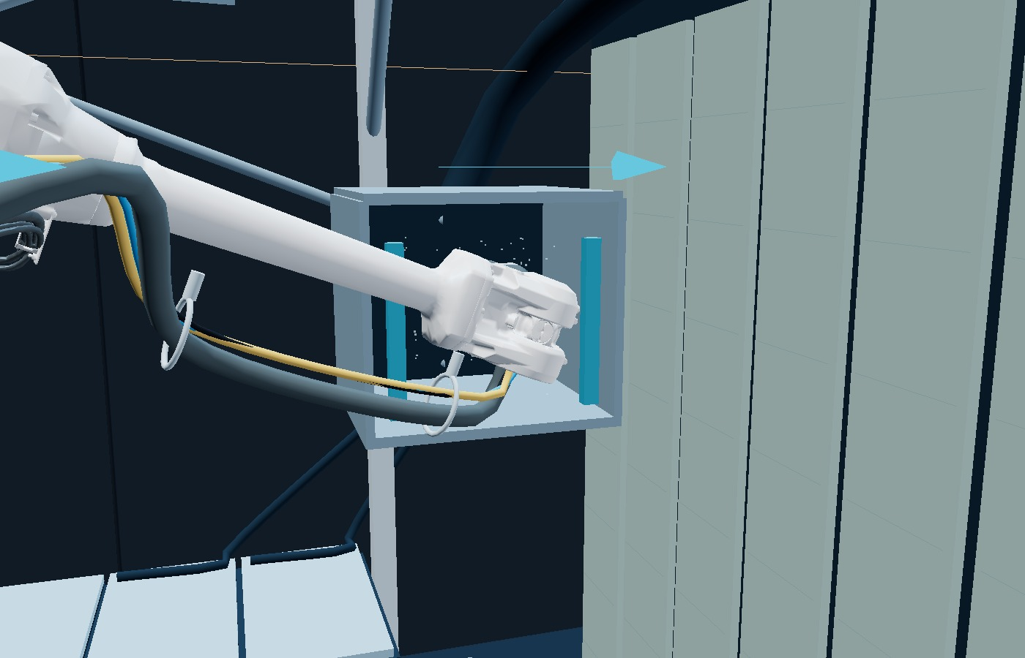
R8 CELL DESIGN
Attached-tool and robot decontamination
Keep the tool attached
After trimming or sanding, present the tool, wrist and distal arm to the contained cleaning hood.
Vacuum before air
Use vacuum first. Add controlled filtered air only while extraction captures the displaced residue.
Clean the dock
Vacuum closed lids and seal surrounds before opening and returning the cleaned head.
AETEC · DSO · 2 October 2026 · Concept for engineering review
20
Notes:
HSE LEV guidance: https://www.hse.gov.uk/lev/ and https://www.hse.gov.uk/pubns/books/hsg258.htm . R8 proposes captured cleaning; flow, capture and dust properties require engineering design and commissioning.

Slide 21
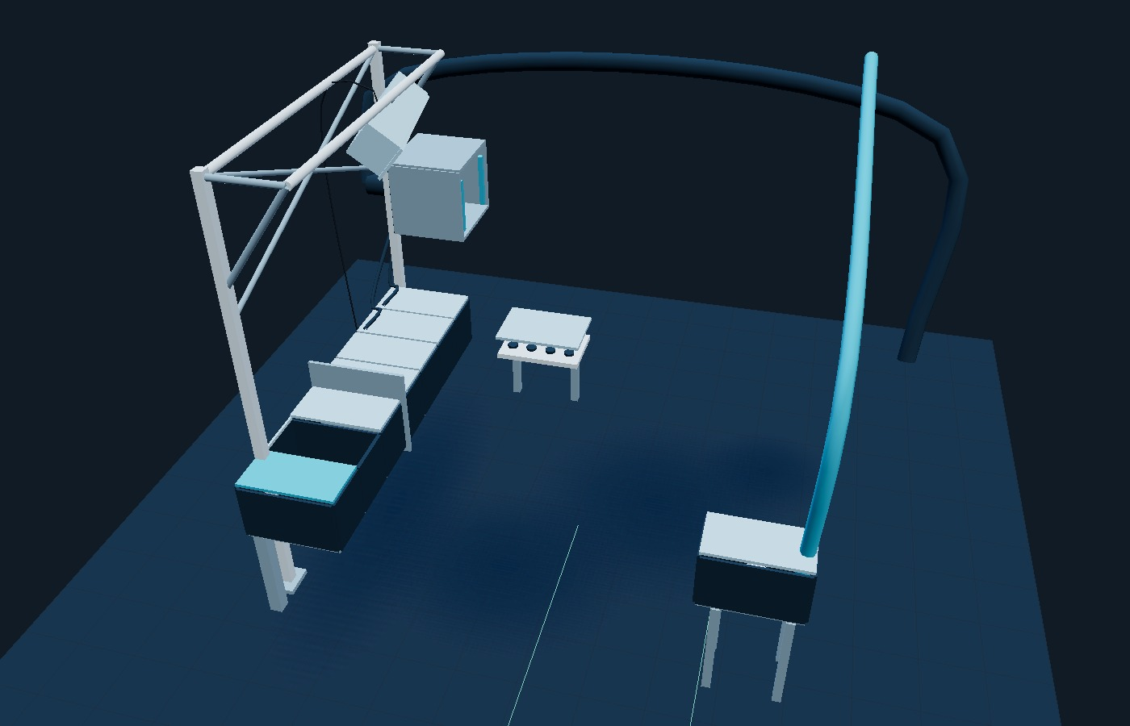
R8 CELL DESIGN
Separate clean, abrasive and wet storage
Clean front cabinet
Scanner and probes remain sealed away from abrasive tools. Optical release requires a clean, stable cell.
Abrasive rear group
Sanding and trimming bays use closed-dock vacuuming. Shared hood cleans dirty robot tooling first.
Extracted wet bay
The nozzle stores across the cell, with separate extraction, sealed services and a capped or flushing receiver.
AETEC · DSO · 2 October 2026 · Concept for engineering review
21
Notes:
R8 conceptual layout. Scanner to sanding bay centre separation 2.10 m, scanner to trimming 2.52 m. Wet nozzle centre is approximately 3.31 m from scanner in plan. No universal separation criterion is claimed; prove containment and clean release.

Slide 22
R8 CELL DESIGN
Wet-bay ventilation and nozzle care
Solvent vapour can accumulate inside an enclosed nozzle bay.
Dedicated extraction draws contaminated air away from the receiver and prevents discharge into clean metrology storage. Prove airflow and interlock access and flushing against the supplier’s assessed conditions.
A cap or approved contained flushing receiver controls nozzle drying and paint residue. Ventilation and nozzle maintenance serve different purposes.
Select the fan, duct, electrical equipment and hazardous-area protection from the actual coating SDS and assessed zone. Airflow and clearance times remain commissioning values.
AETEC · DSO · 2 October 2026 · Concept for engineering review
22
Notes:
HSE: https://www.hse.gov.uk/construction/healthrisks/hazardous-substances/spraying.htm ; https://www.hse.gov.uk/lev/ . User requested VOC explanation. No ATEX approval for the substituted ABB IRB 4600 is claimed without the exact supplier protection scope.

Slide 23
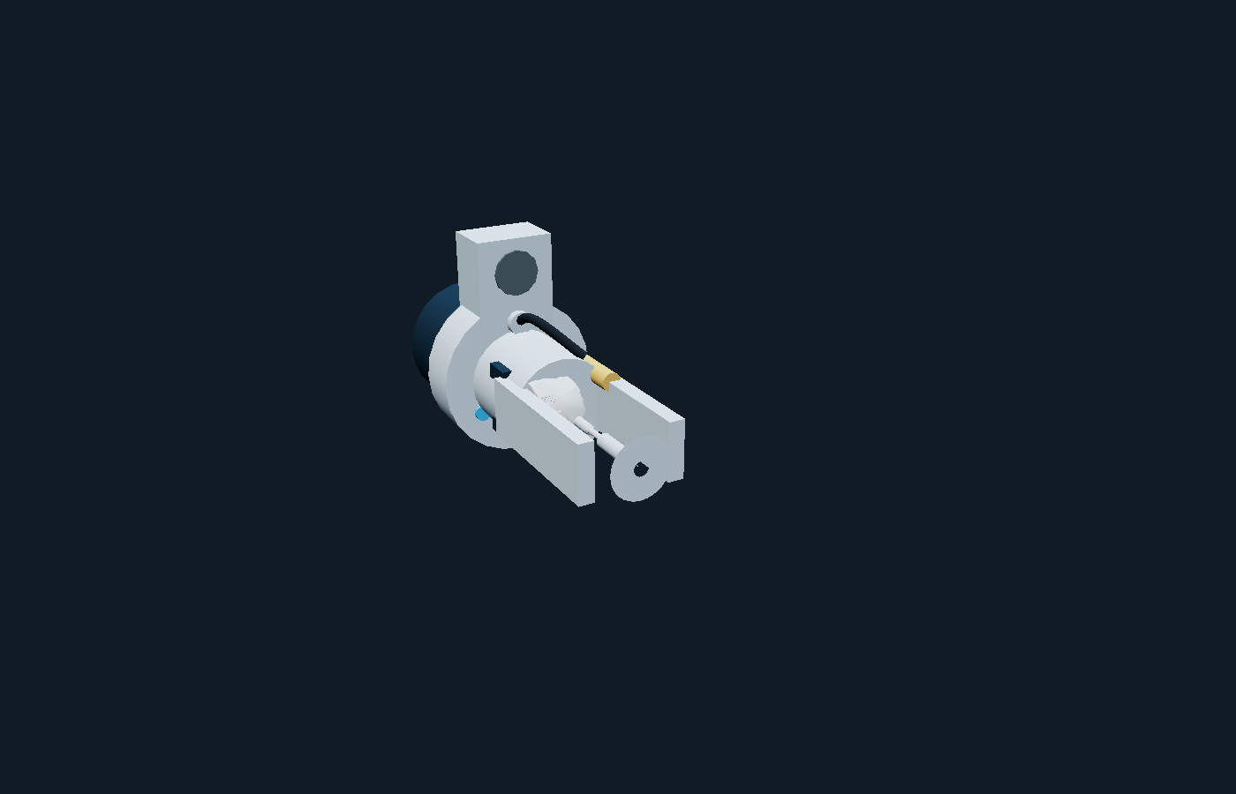
R8 CELL DESIGN
Optical and contact verification
Protected optical scan
Scanner, C-Track and fixed targets open only after coating stability and verified clean release.
Needle thickness
20, 32 or 40 approved sites. Reference-foot differential depth, qualified endpoint and puncture disposition.
Optional touch probe
Qualify on the ceramic sphere, check fixture and part, then recheck drift. Establish system uncertainty.
AETEC · DSO · 2 October 2026 · Concept for engineering review
23
Notes:
User R6 metrology scope retained. Needle probing is destructive. Ceramic-sphere qualification does not confer CMM accuracy. Earlier probing additions remain unpriced variations.

Slide 24
R8 COMMERCIAL BASIS
Four separate POC packages
POC work package | Amount SGD
Scanning | 100,000
Spraying including POC booth | 200,000
Adaptive trimming including pocket opening | 150,000
Adaptive sanding | 100,000
Total excluding GST | 550,000
Trimming and sanding are separate packages. Shared C4 robot/tool cleaning infrastructure is charged once.
Payment 30% / 30% / 20% / 20%: S$165,000 / S$165,000 / S$110,000 / S$110,000. Earlier hardware substitutions and probing variations require reconciliation.
AETEC · DSO · 2 October 2026 · Concept for engineering review
24
Notes:
Source: user prices 2 October 2026 and retained scanning/spraying baseline. Arithmetic: 100000+200000+150000+100000=550000. Detailed budget allocations and terms: AETEC_DSO_POC_Detailed_Quotation_R8.docx.

Slide 25
R8 CELL DESIGN
POC deliverables and release evidence
Process evidence
Adaptive edge and pocket cuts, coating correction maps, cleaning trials, contact records and agreed acceptance results.
Digital deliverables
Editable technical proposal and quotation, complete web simulation, narrated film with six moving AETEC watermarks and Cloudflare upload package.
Engineering release
Native CAD translation, fixture retention, tool loads, exact paths, service routing, capture performance and accepted explosion-protection configuration.
Acceptance basis
One agreed trial matrix. Witnessed reviews and bounded correction iterations. Final production supply and installation are separately quoted.
AETEC · DSO · 2 October 2026 · Concept for engineering review
25
Notes:
Scope follows R8 quotation and user instructions. The simulation is an engineering concept, not a production robot program. Six moving watermark instances each contain the AETEC logo and name. Repeated exchange and cap handling are accelerated.

